Slide 1
Registration under gst law
Ca varsha lund

Slide 2
Advantages of registration
He is legally recognized as supplier or goods or services or both.
He is legally authorized to collect taxes from his customers and pass on the credit of the taxes paid on the goods or services supplied to the recipient.
He can claim input tax credit of taxes paid.
Registered person can gain trust from customers.

Slide 3
Persons liable for registration
Those who exceed the turnover limit
Those who are registered under the previous law
In case of transfer of business on account of succession, transferee liable to get registered from the date of succession of business.
In case of amalgamation / demerger by an order of High Court etc.
Transferee liable to get registered from the date on which Registrar of Companies issues incorporation certificate giving effect to order of High Court

Slide 4
Aggregate Turnover
Taxable Supplies
Exempt Supplies
Exports
Inter State Supplies
Aggregate Turnover excludes
Inward Supplies under Reverse Charge Mechanism
2. CGST / SGST / UTGST / IGST

Slide 5
Threshold limit for registration
Supplier of Notified Goods (Ice cream and other edible ice , whether or not containing cocoa , pan masala, tobacco and manufactured tobacco substitutes
Rs. 10 lakhs | Rs. 20 lakhs
Manipur , Mizoram, Nagaland, Tripura | Remaining States and Union Territories
Supplier of Goods other than notified goods
Rs. 10 lakhs | Rs. 20 lakhs | Rs. 40 lakhs
Manipur , Mizoram, Nagaland, Tripura | Arunachal Pradesh ,Meghalaya , Puducherry, Sikkim , Telangana, Uttarakhand | Remaining States and Union Territories
Supplier of Services / Goods and Services
Rs. 10 lakhs | Rs. 20 lakhs
Manipur , Mizoram, Nagaland, Tripura | Remaining States and Union Territories

Slide 6
Persons not liable for registration
Persons engaged exclusively in supplying goods / services / both not liable to tax.
Agriculturist to the extent of supply of produce of cultivation of land.
Persons engaged exclusively in supplying goods/ services/ both wholly exempt from tax.
Specified category of persons notified by the government.

Slide 7
Compulsory registration in certain cases
Person making any inter state taxable supply of goods
Casual Taxable Persons making taxable supply
Persons required to pay tax under reverse charge
E- Commerce operator
Non resident taxable person
A person required to deduct tax
Input service distributor

Slide 8
Registration by casual taxable person
Compulsory Registration (Exception: Person making supply handicraft goods)
Cannot opt for composition scheme
Advanced deposit of tax
Registration to be obtained at least 5 days prior to the undertaking business
The certificate of registration shall be valid for the period specified in the application or 90 days from the effective date of registration whichever is earlier. (can be extended for a maximum period of 90 days)

Slide 9
Registration by non resident taxable person
Compulsory Registration
Cannot opt for composition scheme
Can apply using a valid passport
Advanced deposit of tax
Registration to be obtained at least 5 days prior to the undertaking business
The certificate of registration shall be valid for the period specified in the application or 90 days from the effective date of registration whichever is earlier. (can be extended for a maximum period of 90 days)

Slide 10
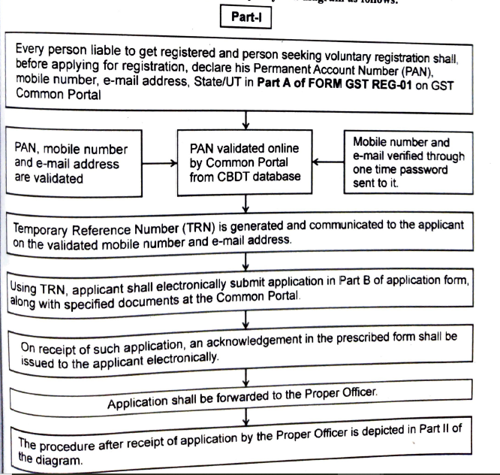
Procedure for registration

Slide 11
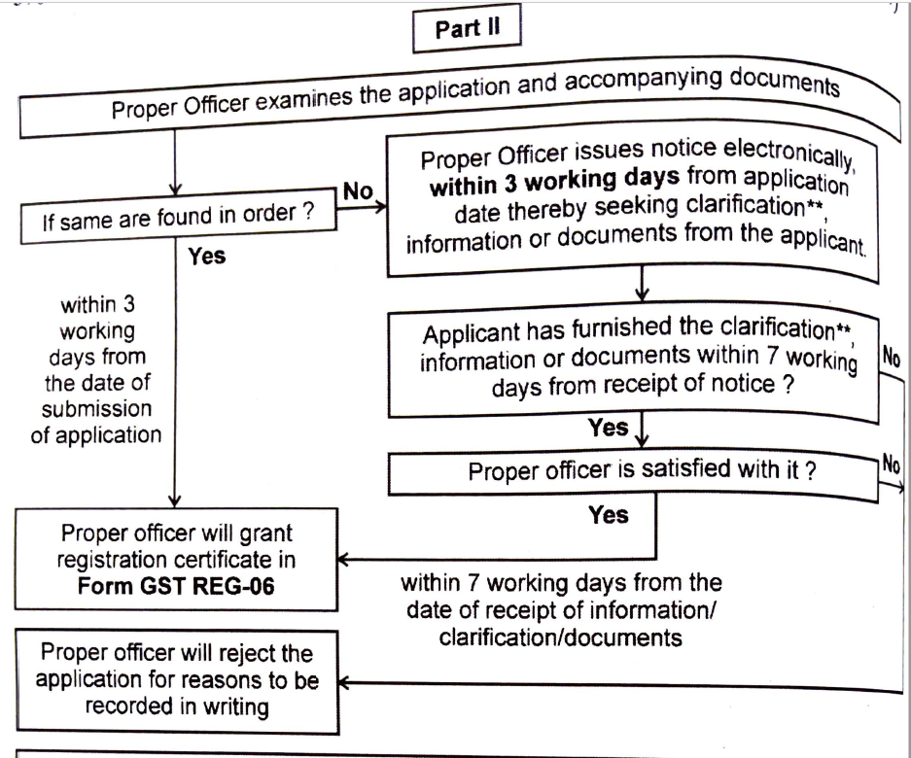

Slide 12
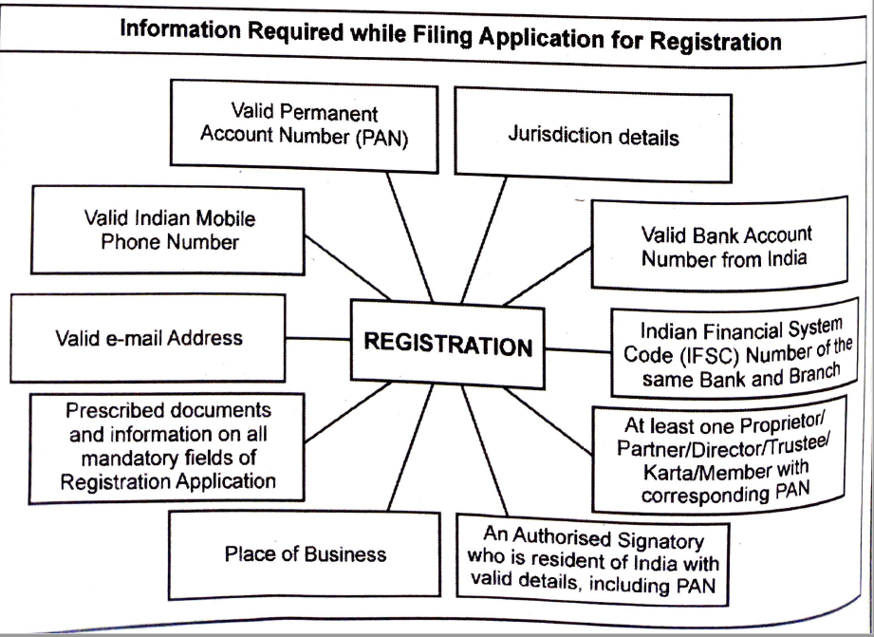

Slide 13
Effective Date of Registration
Application for registration | Effective date of registration
Submitted within 30 days from the date on which the person becomes liable for registration. | Date on which he became liable for registration.
Submitted after 30 days from the date on which the person becomes liable for registration. | Date of grant of registration.
Submitted for voluntary registration while being within the threshold limit for paying tax. | Date of order of registration.

Slide 14
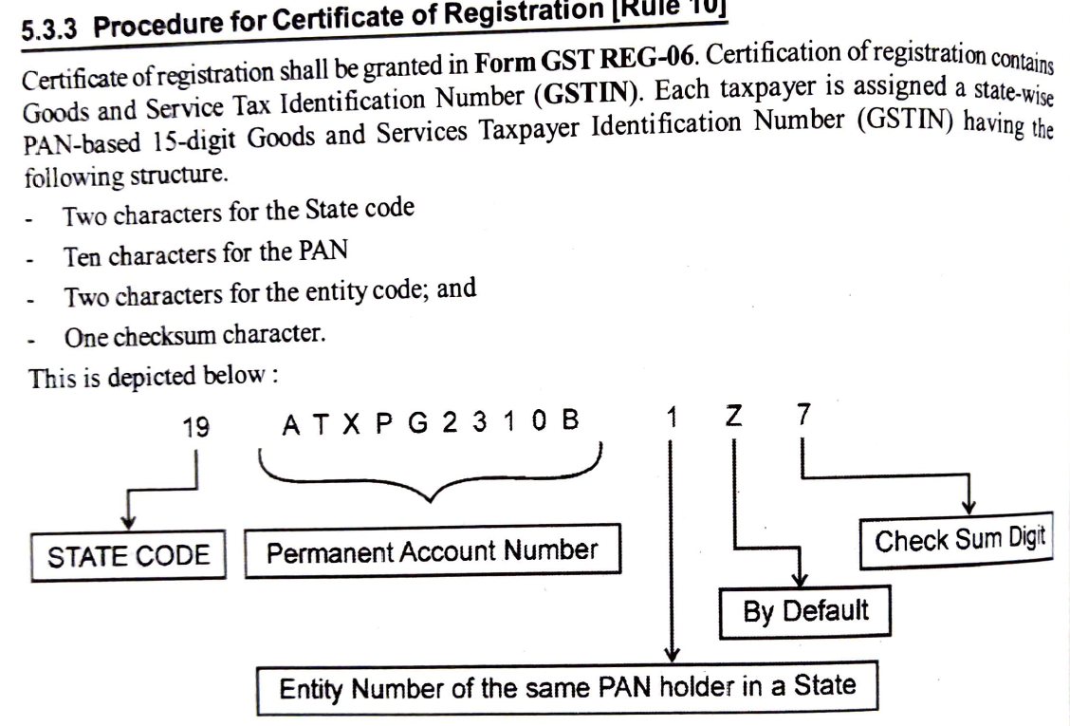

Slide 15
Some other concepts
Deemed Registration
Cancellation or Suspension of registration

Slide 16
Thank you

